Slide 1
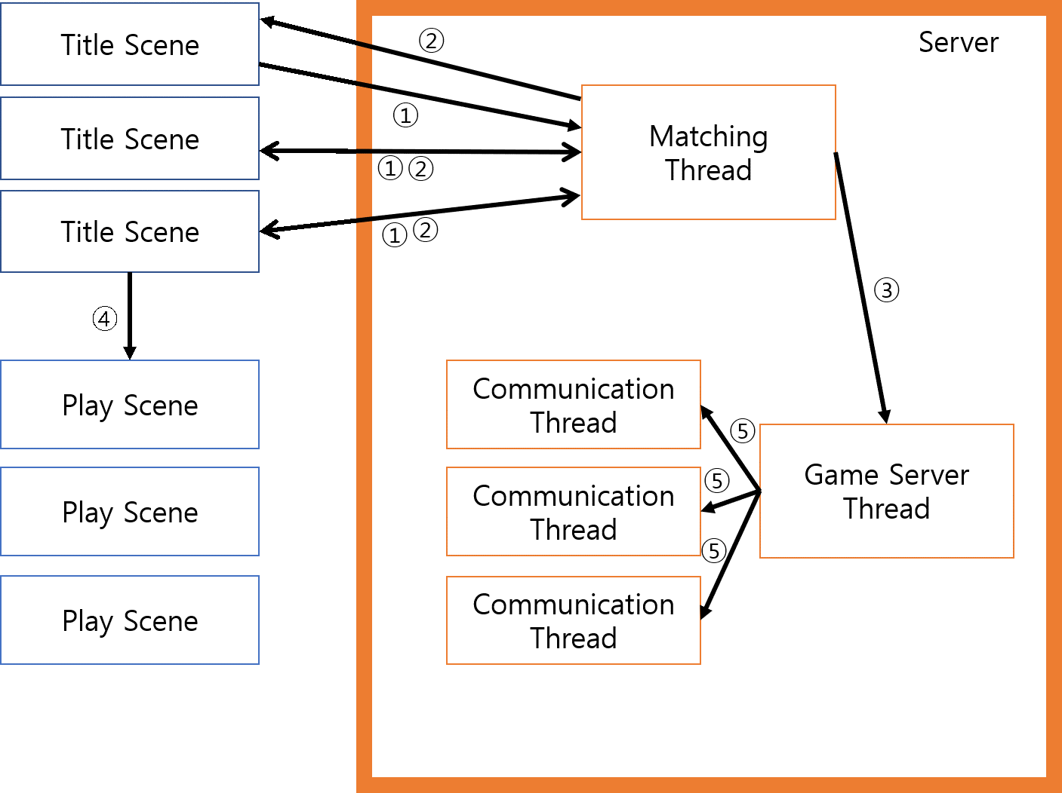
⑥

Slide 2
③
Player
①
Communication
Thread
Server
⑤
Game Server
Thread
④
②
③
Player
Communication
Thread
①⑤
②④
GameServer
ThreadData
④
②
Player
Communication
Thread
①⑤

Slide 3
Client
Server
Main
Create Matching Thread
Connect
Listen
Send
Recv
Recv
Send
Create Game Server Thread
Change Play Scene
Create Communication Thread
Send
Recv
Game Update
Recv
Send
Game End
Delete Communication Thread
Delete Game Server Thread

